Slide 1


ECEN 403
Midterm Presentation
Matrix 1 / “Scooter Juice”
Connor Cottongame
John Dusterhoff
Blake Hallam
Oscar Rubio
TA: Hailey Ward
Sponsor: Prof Prasad Enjeti

Slide 2


Project Summary
Problem statement:
Current electric scooter chargers are bulky and inconvenient to use, requiring large, external rectifiers to charge their batteries, much like a laptop charger.
Our Solution:
This team will design and build an IOBC (Integrated On-Board Charger), allowing the scooter to be charged directly from an AC power source.
This charger will use the existing inverter components in the scooter as a rectifier in order to charge the battery.
Notes:
Connor

Slide 3
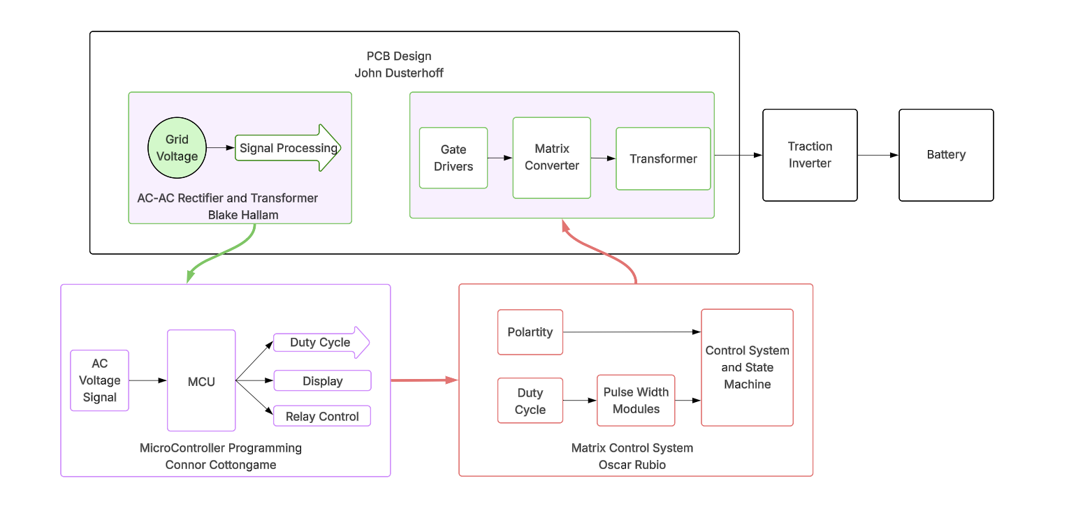
System Overview
Notes:
Blake

Slide 4
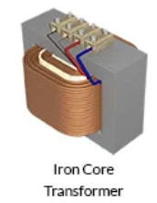
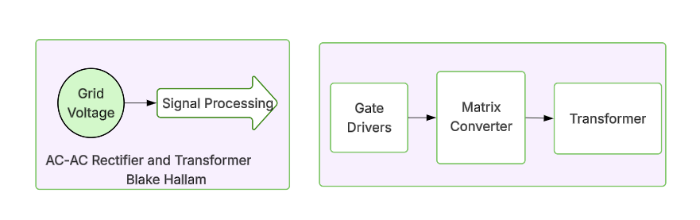
AC-AC Rectifier and Transformer
Blake Hallam
Sends signals to the MCU and FPGA to gather information on input voltage.
  Voltage and current magnitudes to MCU
  Frequency, polarity, and Zero-cross timing to FPGA
Rectifies low-frequency AC voltage to high-frequency AC voltage.
Incorporates a transformer for isolation and to step down the voltage.
Sends voltage to scooter traction board to be rectified to DC voltage for battery.
Image Source: https://circuitdigest.com/tutorial/different-types-of-transformers-and-their-applications

Slide 5
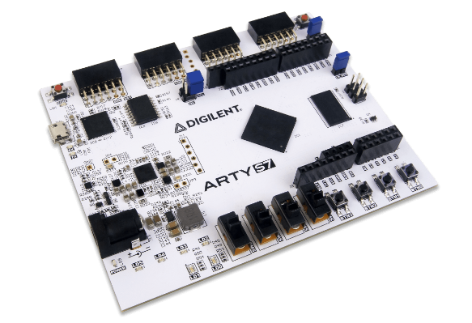
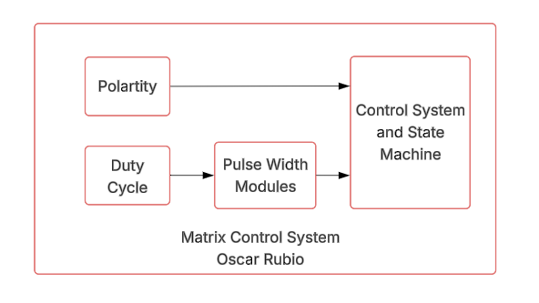
Matrix Control System
Oscar Rubio
Will receive duty cycle from MCU and polarity from signal processing
FPGA will trigger the MOSFETs to control current flow to the transformer using gate drivers
FPGA will be programmed using Verilog
Ensure the MOSFETs turn on in order and timing
Kill the system if there is excess current or grid voltage (V_{g}) is 0 V
Image Source:
https://digilent.com/shop/arty-s7-spartan-7-fpga-development-board/?srsltid=AfmBOopXaJSpsKnGcGY9UQoHQv9MwysVhH6rDnQ1_hIt1NdxmXO8spaL

Slide 6
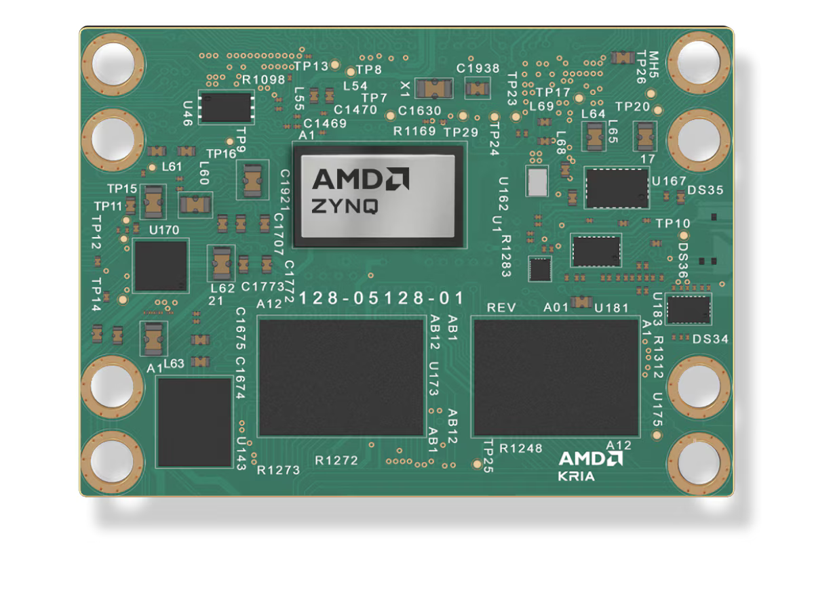
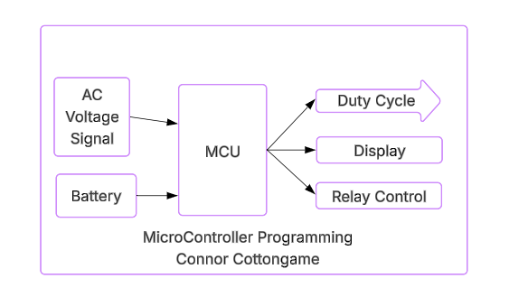
Microcontroller Programming
Connor Cottongame
Controls power being delivered to the battery
Will be implemented in C on ARM cores
Must deliver appropriate current to battery depending on charge state.
This will be done using a PID to keep charging current constant / smooth
Will communicate with FPGA to adjust current delivery
Charge rate, battery percentage, and estimated charge time will be shown on a small OLED display
Will control relays to change scooter between “drive” / “charge” mode (relays for motor, charger)
https://www.amd.com/en/products/system-on-modules/kria/k24/k24c-commercial.html

Slide 7
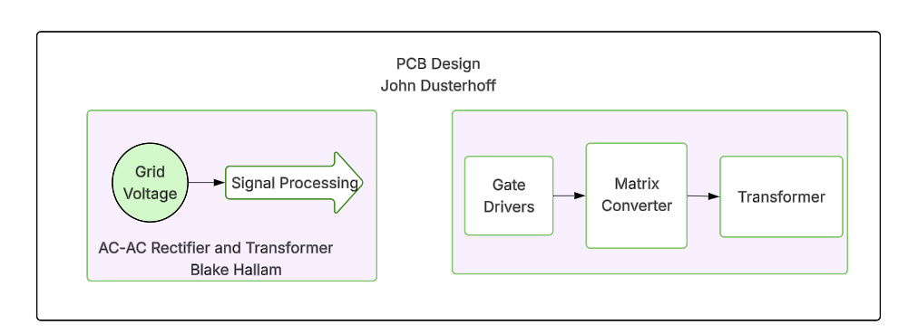
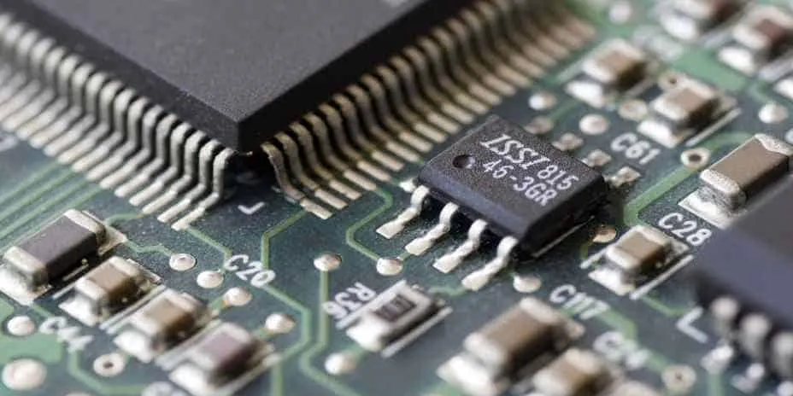
PCB Design
John Dusterhoff
Design of the PCB that will hold the FPGA and microcontroller that are being programmed by other members of the team
Also handling power delivery to these subsystems
Isolation to keep ground plane of primary side and secondary sides separate
The 2 layer PCB will be designed in Altium
Stepping down the voltage to supply the FPGA and microcontroller
https://www.fs-pcba.com/what-is-an-integrated-circuit-and-its-types/

Slide 8
Execution & Validation
 | 1/28 - today | 2/11 | 2/25 | 3/18 | 4/8
AC-AC Rectifier/ Transformer (Blake Hallam) | Determine the transformer and MOSFETs to be used. Drawn, by hand, necessary circuits. | Design circuits in Multisim | Test AC-AC rectifier on breadboard (output waveform) and Stepdown of transformer. | Test signals to FPGA and MCU | Validate Full functionality of signal processing, AC-AC rectifier, and Transformer.
Matrix Control System (Oscar Rubio) | Install AMD Vivado and determine FPGA that will be used | Draft the full digital logic, program the Kill system | Test the Kill System, Program MOSFET control logic | Test the MOSFET control system | Verify full functionality of control and kill system
Microcontroller Programming (Connor Cottongame) | Specify microcontroller to be used, develop specifications and test cases | Complete flowchart + pseudocode for BMS, PLL, PID, and safety relay control | Implement and debug program in C | Develop user interface | Test charging algorithms and safety using software simulation
Primary PCB Design (John Dusterhoff) | Installed Altium and started planning PCB design | First design draft of PCB | Test the PCB design, Design second draft if necessary | Test power loads to FPGA and MCU, isolation | Validate power to all components, proper interconnects between MCU and FPGA
‹#›
Notes:
John

Slide 9
From Matrix 1/Scooter Juice we thank for your attention, and we will be starting the Q&A now
‹#›

